Slide 1
Ghost fluid methods (part 1)
Stephen Millmore
Laboratory for Scientific Computing

Slide 2
Outline
Principles of the ghost fluid method
The original ghost fluid method
History of ghost fluid methods
Implementation of a ghost fluid method

Slide 3
Outline
Principles of the ghost fluid method
The original ghost fluid method
History of ghost fluid methods
Implementation of a ghost fluid method

Slide 4
Ghost fluid methods
Ghost fluid methods are a class of numerical technique for providing boundary conditions at interfaces between materials, at which the interface is:
Sharp
Implicitly represented
Therefore, they typically use a level set function to define the interface, though volume-of-fluid techniques exist too
Boundary conditions are needed because level set functions are strictly passive; they do not influence the flow at all
As we saw before, naive assumptions as to how to model the interface can lead to non-physical features and oscillations

Slide 5
Dynamic boundary conditions
Ghost fluid methods use the fact that level set methods tell us which cells are directly adjacent to a material boundary
This means we can apply boundary conditions here, in much the same way as we do for cells at the edge of the computational domain
Because both the boundary itself can move, and the conditions are dependent on the materials either side of the boundary, which constantly evolve, they are referred to as dynamic boundary conditions
Because these boundary conditions do depend on two materials, the challenge was to find a thermodynamically consistent technique to achieve this

Slide 6



Ghost fluid method concepts
We shall consider a set up a level set function divides the domain up into two regions

Slide 7


Ghost fluid method concepts
Depending on the sign of the level set function, we know which material model we have

Slide 8

Ghost fluid method concepts
The two materials then exist in the ‘physical model’ over these two regions

Slide 9
Ghost fluid method concepts
However, because the materials are evolved completely separately, their data structure exists over the entire computational domain

Slide 10
Ghost fluid method concepts
The material that exists in the computational domain, but not the physical domain is the ghost fluid

Slide 11
Ghost fluid method concepts
Although the ghost fluid regions are not physical material, they will be used in material update due to the numerical stencil of the method used

Slide 12
Ghost fluid method concepts
The name ghost fluid comes from the concept of ghost zones – if the boundary is fixed, and not another material, we apply standard boundary conditions

Slide 13
Ghost fluid method concepts
The idea behind ghost fluid methods is that we apply boundary conditions, but these must be based on the real material

Slide 14
Ghost fluid method concepts
The challenge is that the two materials have different equations of state – we can’t just use the state as it is

Slide 15
Why can’t we use the state as it is?
The simple answer is that this is not thermodynamically consistent
If we have an interface between air and water, we would suddenly increase (or decrease) the density in the ghost fluid by a factor of 1000
The real question might be what we mean by using the state ‘as it is’?
If we copy across density, momentum and energy, then we will not copy across pressure, temperature or specific internal energy
In other words, we can copy across the state ‘as it is’, provided we find the correct three variables to describe the state

Slide 16
Outline
Principles of the ghost fluid method
The original ghost fluid method
History of ghost fluid methods
Implementation of a ghost fluid method

Slide 17
The original ghost fluid method
Although technically not the first implementation of sharp interface multiphysics boundary conditions, the method referred to as the original ghost fluid method was the first which was able to work for more than a few specific materials and test cases
Fedkiw, Aslam, Merriman and Osher (1999), “A Non-oscillatory Eulerian Approach to Interfaces in Multimaterial Flows (the Ghost Fluid Method)”
Combined the authors’ interests in level set methods and shock thermodynamics
Inspired by approaches which look to mitigate shock heating at reflective boundaries
For these boundaries, some success was seen by forcing the boundary conditions to have constant entropy

Slide 18

Choosing dynamic boundary conditions
We have already discussed how the spontaneous generation of entropy leads to unphysical behaviour
Enforcing constant entropy does indeed stop the spontaneous generation (though perhaps the physical generation as well)

Slide 19
Choosing dynamic boundary conditions
However, before the original ghost fluid method there were no good boundary conditions, so even an overly restrictive condition was an improvement
This gives us one condition on our boundary condition variables – entropy remains constant in the ghost fluid
Constant entropy

Slide 20
Choosing dynamic boundary conditions
The rest of the boundary conditions can now be filled in by considering the behaviour we expect for simple interface configurations
For example, we expect to be able to have an interface at rest between two different materials (and different materials should have different densities)
Constant entropy

Slide 21

Choosing dynamic boundary conditions
For an interface at rest, the only way to stop evolution happening is pressure equilibrium (or normal stress equilibrium)
Constant entropy

Slide 22
Choosing dynamic boundary conditions
Similarly, it should be possible to have an interface moving with a constant velocity – there should be velocity equilibrium
Unfortunately, this does not tell us much, since all possible starting points for pressure and velocity were constant anyway – but we know what variables to consider now!
Constant entropy
Constant entropy, and pressure?
Constant entropy, and velocity?
Constant entropy, velocity and pressure?
Use the real velocity?
Use the real pressure?
Use the real velocity and pressure?

Slide 23
Choosing dynamic boundary conditions
Instead we have to consider what happens when the interface is not at rest, and there is a wave moving across it
Rarefactions are an ideal wave to consider, since we know that these obey constant entropy already
Constant entropy

Slide 24
Choosing dynamic boundary conditions
If we had an interface between two identical materials, ideally, this be indistinguishable to a single-material solution
The only way to enforce this under our current set up is to ensure that variables are copied into the ghost fluid from the real fluid
Constant entropy
Use the real velocity and pressure

Slide 25

Is this all we need?
We now have three conditions for thermodynamically consistent boundary conditions:
Constant entropy across the interface
Velocity copied from the real material to the ghost fluid
Pressure copied from the real material to the ghost fluid
We typically refer to pressure, but this would be a stress component for an elastoplastic solid (assuming you could get this method to work)
Because is a suitable set of variables for closing the equations, if we can specify entropy, we can compute density, and all other variables, in the ghost fluid

Slide 26
Shock waves?
When we worked out our boundary conditions, we mentioned rarefactions and interfaces moving at constant velocity (contact discontinuities), but did not mention shock waves
One of the features of a shock wave is that there is a jump in entropy across the wave
This is one of the key weaknesses of the original ghost fluid method, the boundary conditions do not hold
However, in practice, the original GFM was a very successful method
In part, this is because shock waves are often numerically smeared, hence there is a continuous change in entropy which is captured reasonably well

Slide 27
Applying the boundary conditions
Copying velocity and pressure is straightforward, since these are easy to compute
Extrapolating entropy is used to give us a condition on the density in the ghost fluid
Entropy
Velocity and pressure
Entropy

Slide 28


Extrapolating entropy
Fortunately, we do not have to compute entropy to make a constant extrapolation, but we do need to know how it is defined
For example, for an ideal gas, we have
Rearranging this, with constant entropy, we have
We have enough information to compute the density in the ghost fluid region from this

Slide 29

Extrapolating entropy
We consider two sets of values, the real values, or interface values, which are the fluid values at the last cell before the interface
We also have the ghost fluid values of the same quantities
Note that both real and ghost cells are part of the same material, so have the same adiabatic index

Slide 30

Extrapolating entropy
Since we know all interface values (as these just come from the simulation), and we know the pressure in the ghost region (this comes from the other material), we can work out density in the ghost region
The same process works for all ghost cells in your numerical stencil

Slide 31
Example using the ghost fluid method
Shock tube tests are a standard method for validating a ghost fluid method implementation
In the case of a shock wave hitting a material interface, we expect a pattern of:
transmitted shock wave,
reflected rarefaction
advection of the interface

Slide 32
Assumptions of the original ghost fluid method
We have already mentioned that the original ghost fluid method does not provide the correct behaviour at shock waves
This has always been known, and was discussed in the original paper
However, because the method does work well in practice, and it is easy to implement, it has seen a lot of use
But there are some cases in which the original ghost fluid method does not work at all
At very strong shock waves – it can predict a rarefaction when a shock wave should occur
Across very large density gradients, e.g. at air-water interfaces, though careful choice of equation of state can help
Across very different materials, especially if it is not easy to obtain density from entropy

Slide 33
The isobaric fix
In the original ghost fluid paper, you will see mention of the isobaric fix
This extends the extrapolation of entropy, taking the value from once cell further from the interface
As a result, the isobaric fix also changes the density in the real cell adjacent to the interface
This can help fix issues caused by shock waves in the original ghost fluid method, but it can add additional conservation errors (changing the mass within a cell)
Because of the work done on improving the ghost fluid method, do not worry about the isobaric fix when implementing the original GFM
Instead, it is worth giving an overview of how ghost fluid methods have changed
Entropy
Velocity and pressure
Entropy

Slide 34
Outline
Principles of the ghost fluid method
The original ghost fluid method
History of ghost fluid methods
Implementation of a ghost fluid method

Slide 35
Improving ghost fluid methods
Due to the shortcomings of the ghost fluid method, various improved versions have been developed
Most of these occurred within about 10 years of the first publication, though there is still active development
These developments allow ghost fluid methods to provide a stable multimaterial technique even for strong shock waves or different material properties across the interface
Though these various methods all differ, the underlying techniques do not change; the specification of a ghost fluid region to describe the material interaction at the interface
We summarise some of the notable implementations

Slide 36
The modified ghost fluid method
This was the first major development of the ghost fluid method by Liu, Khoo and Yeo (2002)
The aim of this work was specifically to address the problems suffered when a strong shock wave impacts an interface
Their approach focuses on when the original GFM cannot capture the correct behaviour of the waves (it may predict a rarefaction when physically a shock wave occurs)
Their modification to the method is to predict the wave behaviour at the interface, and thus the star states that would arise from a Riemann problem across the interface, such that the correct wave structure can be obtained
What is the connection between ghost fluid methods and Riemann problems?

Slide 37
Riemann problems and Ghost Fluid Methods
When we set Riemann problem boundary conditions, we are setting a state across the interface which is meant to reproduce the correct wave interaction
This will have three waves (for the Euler equations)
One of these waves is the contact discontinuity, which moves with the material velocity, exactly as the interface does
That means that only one wave propagates into the real material, and one propagates into the ghost fluid
Therefore we can think of the ghost fluid state as acting a bit like a star state, which produces the correct wave moving into the real material
Entropy
Velocity and pressure
Entropy

Slide 38
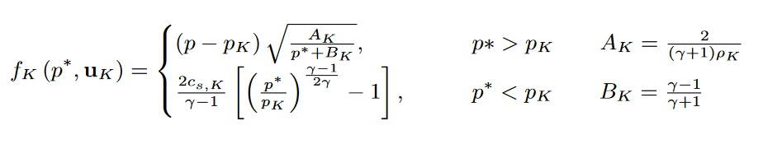
Strong shock waves
Because our ghost fluid is acting like a star state, it should reproduce the correct wave behaviour
Recall that for a shock wave to be generated,
The original ghost fluid method would always use the real pressure at the interface, in other words, it assumes for one of the left or right states
So if the ghost fluid pressure is less than the real pressure, there will always be a rarefaction
But there are many Riemann problems exist where a low pressure, but high density and/or high velocity can generate a shock wave

Slide 39




The modified ghost fluid method
When we first looked at Riemann problems, we introduced characteristics, e.g.
These were used to calculate variables inside the intermediate state, but it was quite a complex process
However, if we linearise, which, in this case, assumes all jumps are a line of constant gradient connecting a known state to an interface state, solving for the ghost fluid variables becomes easier
These expressions are for an interface which lies between cells and

Slide 40
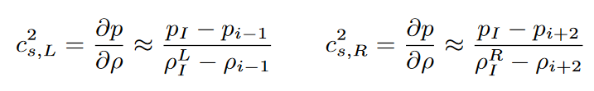

The modified ghost fluid method
Expressions for the sound speed are
Quantities which don’t jump are instead averaged
The system is closed with an assumption that two shock waves are generated, hence intermediate pressure is also given by the two-shock estimate for a Riemann problem (see Toro’s book)
This gives enough information to uniquely define two approximate Riemann problem states

Slide 41
The interface ghost fluid method
This is another modification of the ghost fluid method which uses the characteristic jumps
Developed by Hu and Khoo (2004), it attempts to use more information about constant entropy in the ghost fluid region to provide boundary conditions
This again builds on the idea that the ghost fluid is representing the star state of a Riemann problem
Because we assume constant entropy in the ghost fluid region, we are assuming constant entropy across the wave moving into the real material
We know how to derive expressions for intermediate states across acoustic waves with constant entropy

Slide 42
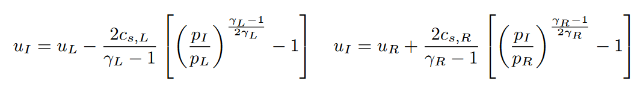
The interface ghost fluid method
These are the expressions for left- and right-moving rarefactions, but for two ideal gasses with different adiabatic index
These are coupled with the same expression for density in the ghost fluid region as the original ghost fluid method
In other words, we have four equations for four unknown variables
But these equations do need to be solved iteratively, much like the exact solver for a standard Riemann problem

Slide 43

The explicit simplified interface method
All ghost fluid methods presented so far have assumed there is a constant entropy across the interface
This is not always true, if there is a temperature gradient in a material, then there is an entropy gradient too
In this case, the constant entropy assumption can cause large error
Lombard and Donat (2005) devised the Explicit Simplified Interface Method (ESIM) to use a continuous (linear) entropy assumption
The idea here is that not only do we know how velocity and pressure jump across the interface (they don’t), we can use Taylor expansions to compute how their derivatives jump

Slide 44

The explicit simplified interface method
Note, we are not computing discontinuous derivatives, just comparing how the derivative either side of the interface, from the interface into the real material, is related in order for entropy to be linearly extrapolated
This then gives us four equations for our four unknown variables in the ghost fluid states
However, it gives us values at the interface itself, not finite volume quantities
So an extrapolation back to cell centres must be made

Slide 45
The real ghost fluid method
Almost all modifications to the GFM have started by identifying the similarity between the ghost fluid state and a Riemann problem star state
And as they improved, they started to solve iterative equations to work out this state, but, under certain assumptions about the wave behaviour
The real ghost fluid method of Wang, Liu and Khoo (2006) used the fact that the standard equation for a Riemann problem is actually a general equation for multiple materials
There is nothing in this equation which say the left and the right states have to have the same equation of state
If we are going to iteratively solve an approximate Riemann problem, why not iteratively solve the actual Riemann problem

Slide 46
The real ghost fluid method
The real ghost fluid method is now the basis of most modern implementations of ghost fluid methods
As a result, we shall look at this technique in much more detail later
But under this approach, no assumptions need to be made that materials are ideal gases, or follow other simple equations of state
As a result, it is ideal for sharp multiphysics interface between any states of matter

Slide 47
The Riemann ghost fluid method
The Riemann ghost fluid method of Sambasivan and UdayKumar (2009) is a modification of the real ghost fluid method
The mixed-material Riemann problem is still used to obtain the intermediate states, however the means of picking the states left and right of the interface changes
This is only an issue in more than one-dimension, where more than one cell can be considered adjacent to the interface (in 1D, there is no practical difference between the Riemann and real GFMs)
For example; an interface passing diagonally through a cell could have adjacent cells to the top and right - which one provides the initial condition for the interface?
We shall return to this later, when considering more than one dimension

Slide 48


The practical ghost fluid method
Once solving Riemann problems became standard, there were no substantial changes to ghost fluid methods
However, Xu, Feng and Liu (2016) introduced a technique which uses the solution to the mixed-material Riemann problem to define the ghost fluid states, but not through direct application
The Riemann problem solution is an evolved state of the problem ( ), so conceptually, using this as the ghost fluid state at time is incorrect (though in the limits of resolution, this can be considered correct)
The practical ghost fluid method attempts to resolve this, by finding a state for the ghost fluid region, e.g. , such that the interaction between and results in u∗
However, this state is not unique, so the practical GFM attempts to use a ‘mirrored structure’ to identify a ghost fluid state

Slide 49
…and more
There are more variants of the GFM than described here, though none that have seen widespread use
All GFMs presented are not conservative; since each cell contains a single material, as the interface passes over a cell centre, the material suddenly ‘switches’, and a mass gain/loss occurs
Typically, the conservation errors are small, and deemed an ‘acceptable’ price for the accuracy of a sharp interface
Attempts have been made to make a conservative ghost fluid method (Nguyen et al. (2002) and Liu et al. (2011)) but typically these suffer from other accuracy issues at the interface

Slide 50
Outline
Principles of the ghost fluid method
The original ghost fluid method
History of ghost fluid methods
Implementation of a ghost fluid method

Slide 51
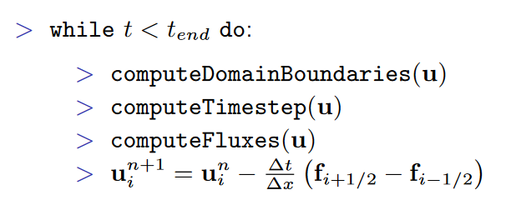
Coding a sharp interface method
One of the main advantages behind ghost fluid methods is that you can build them on top of existing code
Most of the additional work is in creating new functions for the level set equation and the dynamic boundary conditions
Of course, a few changes to make sure you have more than one equation of state and set of variables are necessary

Slide 52
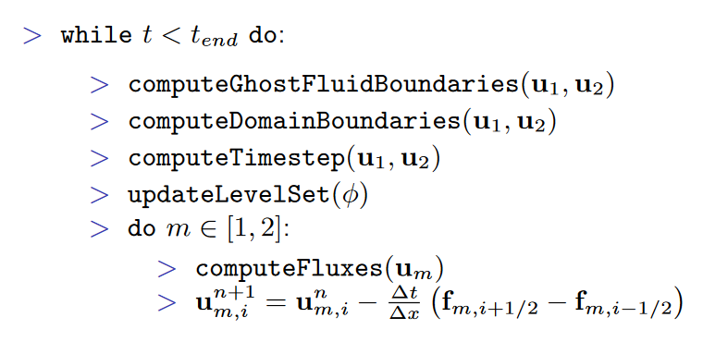
Coding a sharp interface method
The structure of a two-material ghost fluid multiphysics code would then be
There are now two sets of materials
Each material is updated independently
This function can be the same for all materials, or different numerical methods used for each material

Slide 53
Coding a sharp interface method
The structure of a two-material ghost fluid multiphysics code would then be
Usually each material has the same boundary condition, but they don’t have to
The wave speed can be computed for each material and the overall maximum used
Sometimes care is needed to make sure material inside the ghost fluid region doesn’t dominate the time step

Slide 54
Coding a sharp interface method
The structure of a two-material ghost fluid multiphysics code would then be
Ghost fluid boundaries are filled first, as these may then meet the physical boundary
Also, ghost fluid within the numerical stencil of a real cell can contribute to time step
And because the level set position is needed at the current time step, it must happen before the level set update

Slide 55
Coding a sharp interface method
The structure of a two-material ghost fluid multiphysics code would then be
The level set update depends on the current velocity, so must happen before the material update
Technically, it does also need consideration in the stable time step (but it evolves with velocity only)
If you are reinitialising the level set, this is best done after the update

Slide 56
How many ghost cells need setting?
When first describing our ghost fluid method, we illustrated two cells in the ghost fluid region being set (assuming that was our numerical stencil)
But is the enough cells?
Entropy
Velocity and pressure
Entropy

Slide 57
How many ghost cells need setting?
There is nothing wrong with applying boundary conditions to all ghost fluid cells
It is slightly inefficient, but is certain to work, so should be the first thing you try
But what happens if the interface moves during a time step?
Entropy
Velocity and pressure
Entropy

Slide 58
How many ghost cells need setting?
Sometimes a real cell will become a ghost cell – this is not a problem, it simply gets boundary conditions applied next time step
At the same time, a ghost cell becomes a real cell – how do we know if this has a sensible value?
Entropy
Velocity and pressure
Entropy

Slide 59
How many ghost cells need setting?
We could attempt to extrapolate into this newly revealed cell – but that has issues (such as extrapolation over shocks)
Or we could leave it with whatever value it had, and hope for the best (which is easy, and actually works well)
Entropy
Velocity and pressure
Entropy

Slide 60
How many ghost cells need setting?
Although it may seem a bit dodgy, because the ghost cells were, in some ways, analogous to Riemann problem intermediate states, they are a reasonable assumption as to what the behaviour is in this newly revealed cell
But only if the update step hasn’t messed everything up
Entropy
Velocity and pressure
Entropy

Slide 61
How many ghost cells need setting?
As a result, we need to use one extra ghost fluid cell than the numerical stencil requires
Note that these efficiency concerns are only really an issue in more than 1D, where constant extrapolation becomes computationally intensive
Entropy
Velocity and pressure
Entropy

Slide 62
References
Fedkiw, Aslam, Merriman and Osher (1999), “A Non-oscillatory Eulerian Approach to Interfaces in Multimaterial Flows (the Ghost Fluid Method)”
Liu, Khoo, Yeo (2003), “Ghost fluid method for strong shock impacting on material interface”
Hu and Khoo (2004), “An interface interaction method for compressible multifluids”
Lombard and Donat (2005), “The explicit simplified interface method for compressible multicomponent flows”
Wang, Liu and Khoo (2006), “A real ghost fluid method for the simulation of multimedium compressible flow”
Sambasivan and Udaykumar (2009), “Ghost Fluid Method for Strong Shock Interactions Part 1: Fluid Fluid Interfaces”
Xu, Feng and Liu (2016) “Practical Techniques in Ghost Fluid Method for Compressible Multi-Medium Flows”

